Slide 1
Lectuer-4 Database Systems and Applications
Ashish Narang

Slide 2
First Semester
2020-21

Slide 3
Contents
Query languages & Formal query languages for Relational data model
Introduction to Relational Algebra
Relational operators
Set operators
Join operators
Aggregate functions
Grouping operator
Relational Calculus concepts

Slide 4
Relational Algebra Overview
Relational algebra is the basic set of operations for the relational model
These operations enable a user to specify basic retrieval requests (or queries)
The result of an operation is a new relation, which may have been formed from one or more input relations

Slide 5
Relational Algebra Operations
Relational Algebra consists of several groups of operations
Relational Operations
SELECT (symbol: σ (sigma))
PROJECT (symbol: π (pi))
RENAME (symbol: ρ (rho))
JOIN (several variations of JOIN exist)
DIVISION
Relational Algebra Operations From Set Theory
UNION ( ∪ ),
INTERSECTION ( ∩ ),
DIFFERENCE (or MINUS, – )
CARTESIAN PRODUCT ( x )

Slide 6
Unary Relational Operations: SELECT
The SELECT operation (denoted by σ (sigma)) is used to select a subset of the tuples from a relation based on a selection condition.
The general syntax is
σ _{<selection condition>}(R)
Examples:
Select the EMPLOYEE tuples whose department number is 4:
_{DNO = 4} (EMPLOYEE)
Select the employee tuples whose salary is greater than 30,000:
σ _{SALARY > 30,000} (EMPLOYEE)

Slide 7
Contd..
Clauses can be connected by the standard Boolean operators AND, OR, and NOT to form a general selection condition.
For example, to select the tuples for all employees who either work in department 4 and make over $25,000 per year, or work in department 5 and make over $30,000, we can specify the following SELECT operation:
σ (DNO = 4 AND Salary>25000) OR (DNO = 5 AND Salary>30000) (EMPLOYEE)

Slide 8
Contd..
SELECT Operation Properties
The SELECT operation σ _{<selection condition>}(R) produces a relation S that has the same schema (same attributes) as R
SELECT σ is commutative:
σ _{<condition1>}(σ _{< condition2>} (R)) = σ _{<condition2>} (σ _{< condition1>} (R))
Because of commutative property, a cascade (sequence) of SELECT operations may be applied in any order:
σ_{<cond1>}(σ_{<cond2>} (σ_{<cond3>} (R)) = σ_{<cond2>} (σ_{<cond3>} (σ_{<cond1>} ( R)))
A cascade of SELECT operations may be replaced by a single selection with a conjunction of all the conditions:
σ_{<cond1>}(σ< _{cond2>} (σ_{<cond3>}(R)) = σ <cond1> AND < cond2> AND < cond3>(R)
The number of tuples in the result of a SELECT is less than (or equal to) the number of tuples in the input relation R

Slide 9
Unary Relational Operations: PROJECT
PROJECT Operation is denoted by π (pi)
This operation keeps certain columns (attributes) from a relation and discards the other columns.
PROJECT creates a vertical partitioning
The list of specified columns (attributes) is kept in each tuple.
The other attributes in each tuple are discarded.

Slide 10
Contd..
The general form of the project operation is:
π_{<attribute list>}(R)
Example: To list each employee’s first and last name and salary, the following is used:
π_{LNAME, FNAME,SALARY}(EMPLOYEE)
The project operation removes any duplicate tuples
This is because the result of the project operation must be a set of tuples
Mathematical sets do not allow duplicate elements.

Slide 11
Contd..
PROJECT Operation Properties
The number of tuples in the result of projection π_{<list>}(R) is always less or equal to the number of tuples in R
PROJECT is not commutative
π _{<list1>} (π _{<list2>} (R) ) = π _{<list1>} (R) as long as <list2> contains the attributes in <list1>

Slide 12
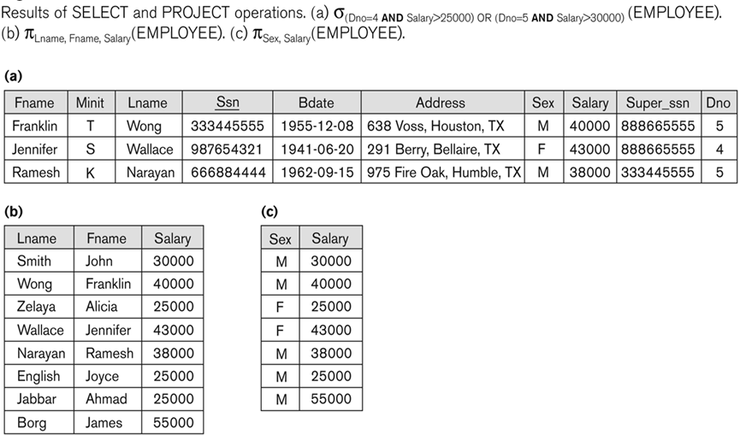
Examples of Applying SELECT and PROJECT Operations

Slide 13
Relational Algebra Expressions
We may want to apply several relational algebra operations one after the other.
Either we can write the operations as a single relational algebra expression by nesting the operations, or
We can apply one operation at a time and create intermediate result relations.
In the latter case, we must give names to the relations that hold the intermediate results.

Slide 14
Single Expression Versus Sequence of Relational Operations (Example)
To retrieve the first name, last name, and salary of all employees who work in department number 5, we must apply a select and a project operation.
We can write a single relational algebra expression as follows:
π_{FNAME, LNAME, SALARY}(σ _{DNO=5}(EMPLOYEE))
OR We can explicitly show the sequence of operations, giving a name to each intermediate relation:
DEP5_EMPS ← σ _{DNO=5}(EMPLOYEE)
RESULT ← π _{FNAME, LNAME, SALARY} (DEP5_EMPS)

Slide 15
Unary Relational Operations: RENAME
The RENAME operator is denoted by ρ (rho)
In some cases, we may want to rename the attributes of a relation or the relation name or both
Useful when a query requires multiple operations
Necessary in some cases (see JOIN operation later)

Slide 16
Contd..
The general RENAME operation ρ can be expressed by any of the following forms:
ρ_{S}(R) changes:
the relation name only to S
ρ_{(B1, B2, …, Bn )}(R) changes:
the column (attribute) names only to B1, B2, …..Bn
ρ_{S (B1, B2, …, Bn )}(R) changes both:
the relation name to S, and
the column (attribute) names to B1, B2, …..Bn

Slide 17
Contd..
For convenience, we also use a shorthand for renaming attributes in an intermediate relation:
If we write:
DEP5_EMPS ← σ _{DNO=5}(EMPLOYEE)
RESULT ← π _{FNAME, LNAME, SALARY} (DEP5_EMPS)
RESULT will have the same attribute names as DEP5_EMPS (same attributes as EMPLOYEE)
If we write:
TEMP ← σ _{DNO=5}(EMPLOYEE)
RESULT (First_name, Last_name,Salary)←
π _{FNAME, LNAME, SALARY} (TEMP)
The 3 attributes of DEP5_EMPS are renamed to First_name, Last_name, Salary

Slide 18
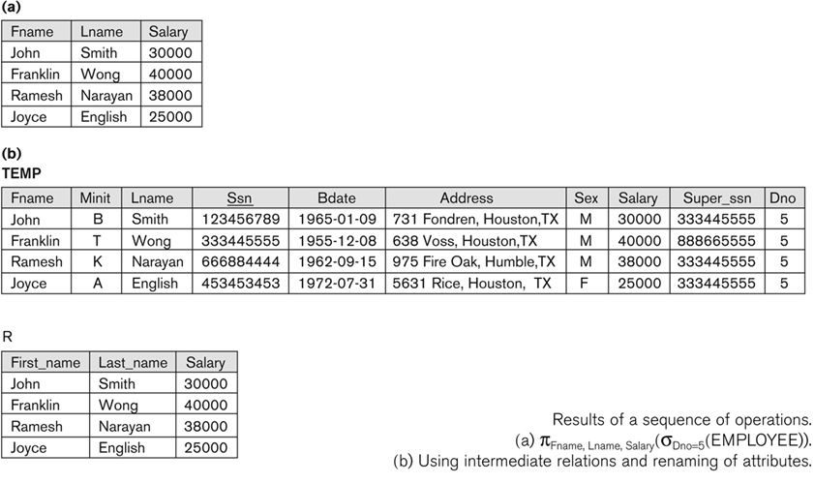
Example of Applying Multiple Operations and RENAME

Slide 19
Relational Algebra Operations from Set Theory: UNION
UNION Operation
Binary operation, denoted by ∪
The result of R ∪ S, is a relation that includes all tuples that are either in R or in S or in both R and S
Duplicate tuples are eliminated
The two operand relations R and S must be “type compatible” (or UNION compatible)

Slide 20
Contd..
Example:
To retrieve the social security numbers of all employees who either work in department 5 (RESULT1 below) or directly supervise an employee who works in department 5 (RESULT2 below)
We can use the UNION operation as follows:
DEP5_EMPS ← σ_{DNO=5} (EMPLOYEE)
RESULT1 ← π _{SSN}(DEP5_EMPS)
RESULT2(SSN) ← π_{SUPERSSN}(DEP5_EMPS)
RESULT ← RESULT1 ∪ RESULT2
The union operation produces the tuples that are in either RESULT1 or RESULT2 or both

Slide 21
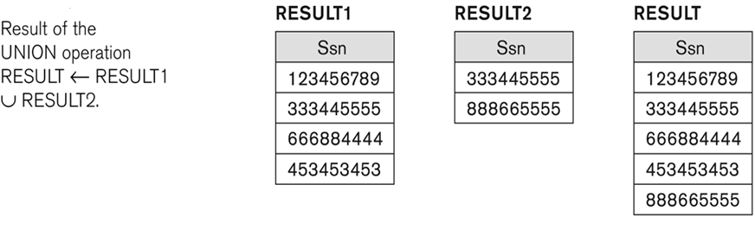
Example of the result of a UNION operation

Slide 22
Relational Algebra Operations from Set Theory: INTERSECTION
INTERSECTION is denoted by ∩
The result of the operation R ∩ S, is a relation that includes all tuples that are in both R and S
The two operand relations R and S must be “type compatible”

Slide 23
Relational Algebra Operations from Set Theory: SET DIFFERENCE
SET DIFFERENCE (also called MINUS) is denoted by –
The result of R – S, is a relation that includes all tuples that are in R but not in S
The two operand relations R and S must be “type compatible”

Slide 24
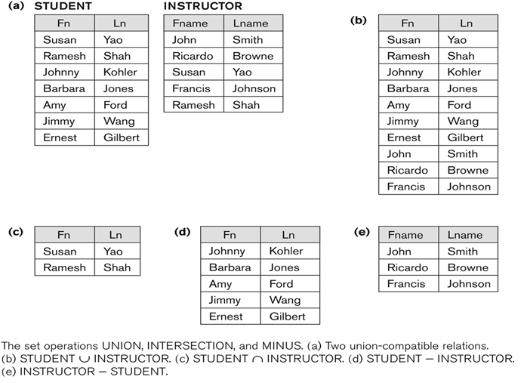
Example to Illustrate the Result of UNION, INTERSECT and Set DIFFERENCE

Slide 25
Some Properties of UNION, INTERSECT, and DIFFERENCE
Notice that both union and intersection are commutative operations; that is
R ∪ S = S ∪ R, and R ∩ S = S ∩ R
Both union and intersection can be treated as n-ary operations applicable to any number of relations as both are associative operations; that is
R ∪ (S ∪ T) = (R ∪ S) ∪ T
(R ∩ S) ∩ T = R ∩ (S ∩ T)
The minus operation is not commutative; that is, in general
R – S ≠ S – R

Slide 26
Relational Algebra Operations from Set Theory: CARTESIAN PRODUCT
CARTESIAN (or CROSS) PRODUCT Operation
This operation is used to combine tuples from two relations in a combinatorial fashion.
Denoted by R(A1, A2, . . ., An) x S(B1, B2, . . ., Bm)
Result is a relation Q with degree n + m attributes:
Q(A1, A2, . . ., An, B1, B2, . . ., Bm), in that order.
If R has n_{R} tuples (denoted as |R| = n_{R} ), and S has n_{S} tuples, then R x S will have n_{R} * n_{S} tuples.
The two operands do NOT have to be "type compatible”

Slide 27
Relational Algebra Operations From Set Theory: CARTESIAN PRODUCT (cont.)
Generally, CROSS PRODUCT is not a meaningful operation
Can become meaningful when followed by other operations
Example :
EMPNAMES ← π _{FNAME, LNAME, SSN} (EMPLOYEE)
EMP_DEPENDENTS ← EMPNAMES x DEPENDENT
EMP_DEPENDENTS will contain every combination of EMPNAMES and DEPENDENT
whether or not they are actually related

Slide 28
Relational Algebra Operations from Set Theory: CARTESIAN PRODUCT (Contd..)
To keep only combinations where the DEPENDENT is related to the EMPLOYEE, we add a SELECT operation as follows
Example (meaningful):
EMPNAMES ← π _{FNAME, LNAME, SSN} (EMPLOYEE)
EMP_DEPENDENTS ← EMPNAMES x DEPENDENT
EMP_DEPENDENTS ← EMPNAMES x DEPENDENT
ACTUAL_DEPS ← σ _{SSN=ESSN}(EMP_DEPENDENTS)
RESULT ← π _{FNAME, LNAME, DEPENDENT_NAME} (ACTUAL_DEPS)
RESULT will now contain the name of employees and their dependents

Slide 29
Binary Relational Operations: JOIN
JOIN Operation (denoted by )
The sequence of CARTESIAN PRODUCT followed by SELECT is used quite commonly to identify and select related tuples from two relations
A special operation, called JOIN combines this sequence into a single operation
This operation is very important for any relational database with more than a single relation, because it allows us combine related tuples from various relations
The general form of a join operation on two relations
R(A1, A2, . . ., An) and S(B1, B2, . . ., Bm) is:
R _{<join condition>}S
where R and S can be any relations that result from general relational algebra expressions.

Slide 30
Some Properties of JOIN
Consider the following JOIN operation:
R(A1, A2, . . ., An) _{R.Ai=S.Bj} S(B1, B2, . . ., Bm)
Result is a relation Q with degree n + m attributes:
Q(A1, A2, . . ., An, B1, B2, . . ., Bm), in that order.
The resulting relation state has one tuple for each combination of tuples—r from R and s from S, but only if they satisfy the join condition r[Ai]=s[Bj]
Hence, if R has n_{R} tuples, and S has n_{S} tuples, then the join result will generally have less than n_{R} * n_{S} tuples.
Only related tuples (based on the join condition) will appear in the result

Slide 31

Binary Relational Operations: JOIN
To illustrate JOIN, suppose that we want to retrieve the name of the manager of each department.
To get the manager’s name, we need to combine each department tuple with the employee tuple whose Ssn value matches the Mgr_ssn value in the department tuple.
We do this by using the JOIN operation and then projecting the result over the necessary attributes, as follows:

Slide 32
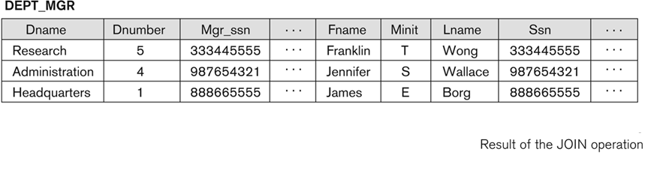
Example of Applying the JOIN Operation

Slide 33
Theta JOIN
The general case of JOIN operation is called a Theta-join: R _{theta} S
The join condition is called theta
Theta can be any general boolean expression on the attributes of R and S; for example:
R.A_{i}<S.B_{j} AND (R.A_{k}=S.B_{l} OR R.A_{p}<S.B_{q})
Most join conditions involve one or more equality conditions “AND”ed together; for example:
R.A_{i}=S.B_{j} AND R.A_{k}=S.B_{l} AND R.A_{p}=S.B_{q}

Slide 34
Binary Relational Operations: NATURAL JOIN Operation
NATURAL JOIN Operation
Another variation of JOIN called NATURAL JOIN — denoted by * — was created to get rid of the second (superfluous) attribute in an EQUIJOIN condition.
standard definition of natural join requires that the two join attributes, or each pair of corresponding join attributes, have the same name in both relations
If this is not the case, a renaming operation is applied first.

Slide 35
Binary Relational Operations NATURAL JOIN (cont.)
Example: To apply a natural join on the DNUMBER attributes of DEPARTMENT and DEPT_LOCATIONS, it is sufficient to write:
DEPT_LOCS ← DEPARTMENT * DEPT_LOCATIONS
Only attribute with the same name is DNUMBER
An implicit join condition is created based on this attribute:
DEPARTMENT.DNUMBER=DEPT_LOCATIONS.DNUMBER
Another example: Q ← R(A,B,C,D) * S(C,D,E)
The implicit join condition includes each pair of attributes with the same name, “AND”ed together:
R.C=S.C AND R.D=S.D
Result keeps only one attribute of each such pair:
Q(A,B,C,D,E)

Slide 36
Binary Relational Operations: DIVISION
DIVISION Operation
The division operation is applied to two relations
R(Z) ÷ S(X), where X subset Z. Let Y = Z - X (and hence Z = X ∪ Y); i.e., let Y be the set of attributes of R that are not attributes of S.
For a tuple t to appear in the result T of the DIVISION, the values in t must appear in R in combination with every tuple in S.

Slide 37
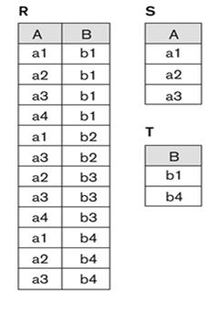
Example

Slide 38


Example
Retrieve the names of employees who work on all the projects that ‘John Smith’ works on.
To express this query using the DIVISION operation, proceed as follows. First, retrieve the list of project numbers that ‘John Smith’ works on in the intermediate relation SMITH_PNOS:
Next, create a relation that includes a tuple whenever the employee whose Ssn is Essn works on the project whose number is Pno in the intermediate relation SSN_PNOS:
Finally, apply the DIVISION operation to the two relations, which gives the desired employees’ Social Security numbers:

Slide 39
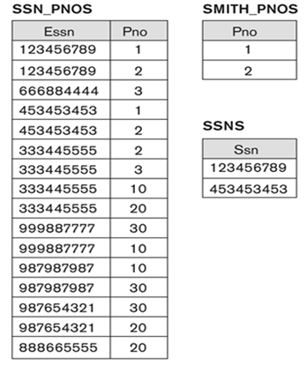
Contd..

Slide 40
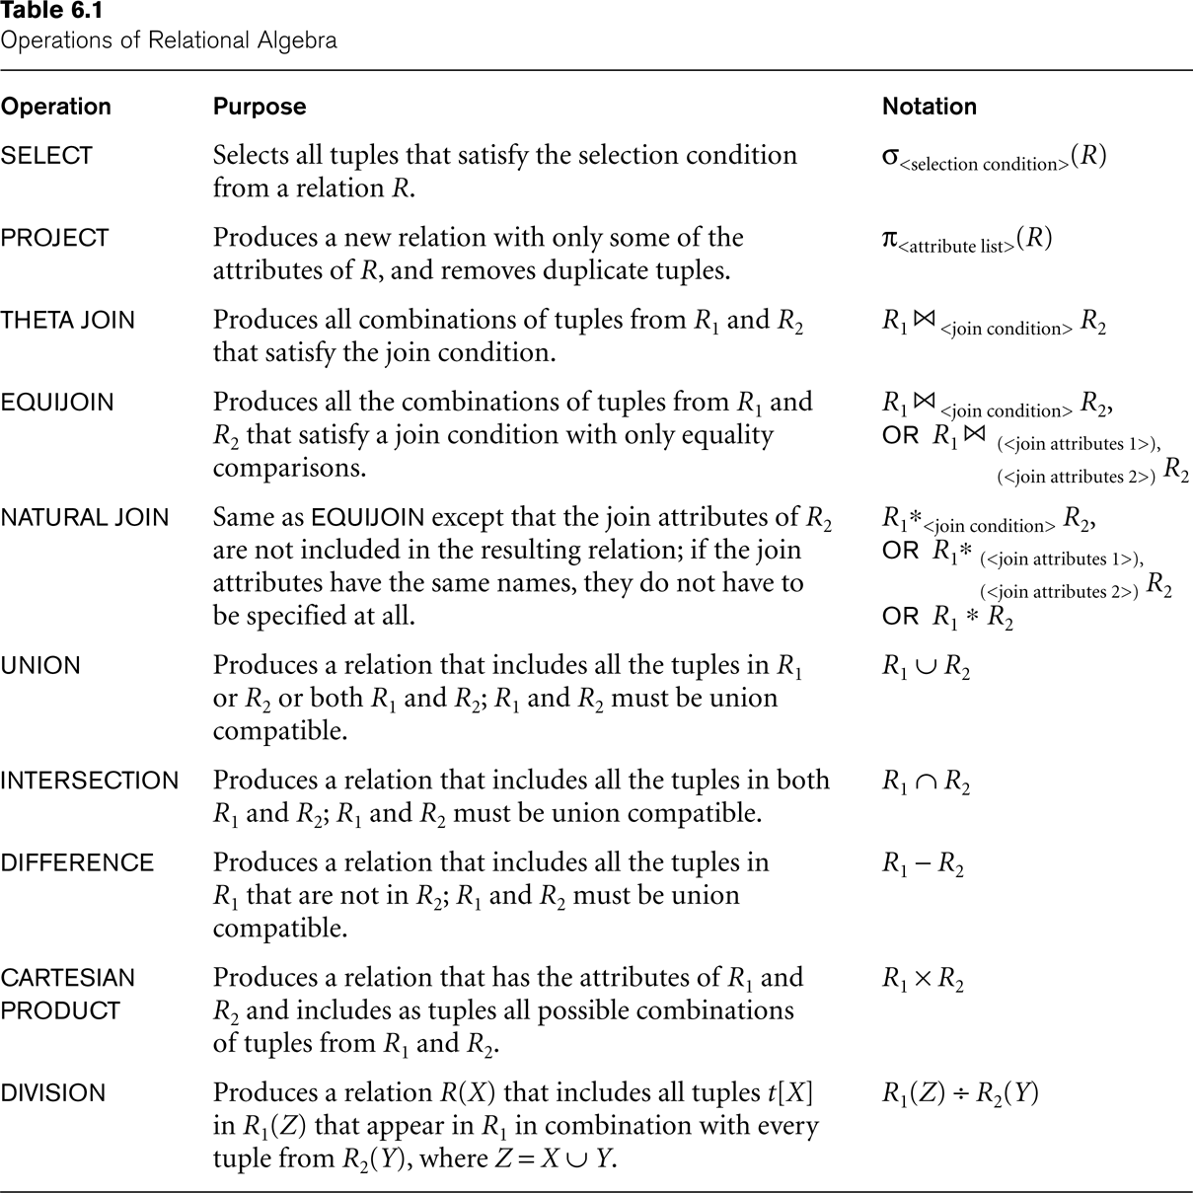
Recap of Relational Algebra Operations

Slide 41
Additional Relational Operations: Aggregate Functions and Grouping
A type of request that cannot be expressed in the basic relational algebra is to specify mathematical aggregate functions on collections of values from the database.
Examples of such functions include retrieving the average or total salary of all employees or the total number of employee tuples.
These functions are used in simple statistical queries that summarize information from the database tuples.
Common functions applied to collections of numeric values include
SUM, AVERAGE, MAXIMUM, and MINIMUM.
The COUNT function is used for counting tuples or values.

Slide 42
Aggregate Function Operation
Use of the Aggregate Functional operation ℱ
ℱ_{MAX Salary} (EMPLOYEE) retrieves the maximum salary value from the EMPLOYEE relation
ℱ_{MIN Salary} (EMPLOYEE) retrieves the minimum Salary value from the EMPLOYEE relation
ℱ_{SUM Salary} (EMPLOYEE) retrieves the sum of the Salary from the EMPLOYEE relation
ℱ_{COUNT SSN, AVERAGE Salary} (EMPLOYEE) computes the count (number) of employees and their average salary
Note: count just counts the number of rows, without removing duplicates

Slide 43
Using Grouping with Aggregation
The previous examples all summarized one or more attributes for a set of tuples
Maximum Salary or Count (number of) Ssn
Grouping can be combined with Aggregate Functions
Example: For each department, retrieve the DNO, COUNT SSN, and AVERAGE SALARY
A variation of aggregate operation ℱ allows this:
Grouping attribute placed to left of symbol
Aggregate functions to right of symbol
_{DNO} ℱ_{COUNT SSN, AVERAGE Salary} (EMPLOYEE)
Above operation groups employees by DNO (department number) and computes the count of employees and average salary per department

Slide 44
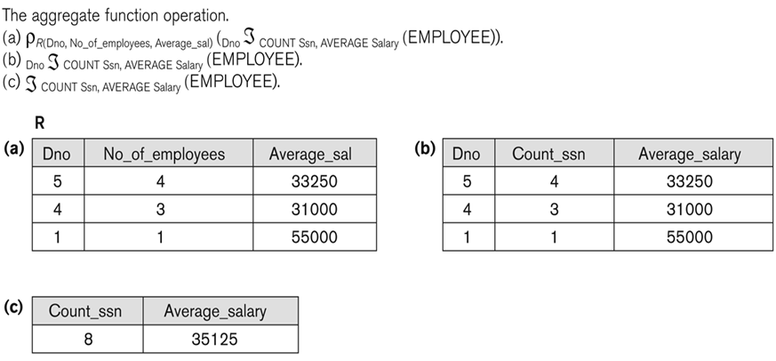
Examples of Applying Aggregate Functions and Grouping

Slide 45
Additional Relational Operations
In NATURAL JOIN and EQUIJOIN, tuples without a matching (or related) tuple are eliminated from the join result.
Tuples with null in the join attributes are also eliminated
This amounts to loss of information.
The OUTER JOIN Operation
A set of operations, called OUTER joins, can be used when we want to keep all the tuples in R, or all those in S, or all those in both relations in the result of the join, regardless of whether or not they have matching tuples in the other relation.

Slide 46
Additional Relational Operations (cont.)
The left outer join operation keeps every tuple in the first or left relation R in R S; if no matching tuple is found in S, then the attributes of S in the join result are filled or “padded” with null values.
A similar operation, right outer join, keeps every tuple in the second or right relation S in the result of R S.
A third operation, full outer join, denoted by keeps all tuples in both the left and the right relations when no matching tuples are found, padding them with null values as needed.
TEMP (EMPLOYEE (ssn=Mgr_ssn)DEPARTMENT)
RESULT π_{FNAME, Minit,Lname,Dname}(TEMP)

Slide 47
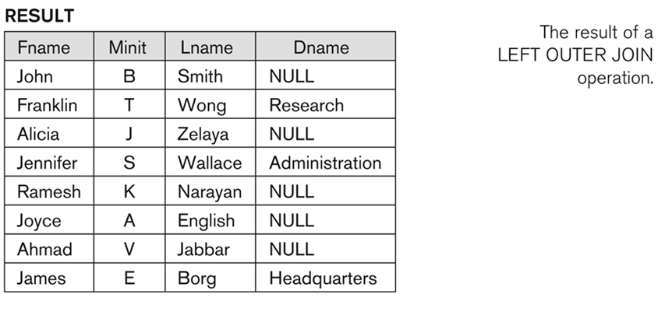
Additional Relational Operations (cont.)

Slide 48
Examples of Queries in Relational Algebra
Q1: Retrieve the name and address of all employees who work for the ‘Research’ department.
RESEARCH_DEPT ← σ DNAME=’Research’ (DEPARTMENT)
RESEARCH_EMPS ← (RESEARCH_DEPT_{DNUMBER= DNO}EMPLOYEE)
RESULT ← π FNAME, LNAME, ADDRESS (RESEARCH_EMPS)
Q2: Retrieve the names of employees who have no dependents.
ALL_EMPS ← π SSN(EMPLOYEE)
EMPS_WITH_DEPS(SSN) ← π ESSN(DEPENDENT)
EMPS_WITHOUT_DEPS ← (ALL_EMPS - EMPS_WITH_DEPS)
RESULT ← π LNAME, FNAME (EMPS_WITHOUT_DEPS * EMPLOYEE)

Slide 49
Relational Calculus
A relational calculus expression creates a new relation, which is specified in terms of variables that range over rows of the stored database relations (in tuple calculus).
In a calculus expression, there is no order of operations to specify how to retrieve the query result—a calculus expression specifies only what information the result should contain.

Slide 50
Relational Calculus(Contd..)
Relational calculus is considered to be a nonprocedural language.
This differs from relational algebra, where we must write a sequence of operations to specify a retrieval request; hence relational algebra can be considered as a procedural way of stating a query.

Slide 51
Tuple Relational Calculus
Example: To find the first and last names of all employees whose salary is above 50,000, we can write the following tuple calculus expression:
{t.FNAME, t.LNAME | EMPLOYEE(t) AND t.SALARY>50000}
The condition EMPLOYEE(t) specifies that the range relation of tuple variable t is EMPLOYEE.
The first and last name (PROJECTION π_{FNAME, LNAME}) of each EMPLOYEE tuple t that satisfies the condition t.SALARY>50000 (SELECTION σ _{SALARY >50000}) will be retrieved.

Slide 52
The Existential and Universal Quantifiers
Two special symbols called quantifiers can appear in formulas; these are the universal quantifier (∀) and the existential quantifier (∃).
Informally, a tuple variable t is bound if it is quantified, meaning that it appears in an (∀ t) or (∃ t) clause; otherwise, it is free.
If F is a formula, then so are (∃ t)(F) and (∀ t)(F), where t is a tuple variable.
The formula (∃ t)(F) is true if the formula F evaluates to true for some (at least one) tuple assigned to free occurrences of t in F; otherwise (∃ t)(F) is false.
The formula (∀ t)(F) is true if the formula F evaluates to true for every tuple (in the universe) assigned to free occurrences of t in F; otherwise (∀ t)(F) is false.

Slide 53
The Existential and Universal Quantifiers
∀ is called the universal or “for all” quantifier because every tuple in “the universe of” tuples must make F true to make the quantified formula true.
∃ is called the existential or “there exists” quantifier because any tuple that exists in “the universe of” tuples may make F true to make the quantified formula true.

Slide 54
The Existential and Universal Quantifiers
Example: To find name and address of all employees who work for ‘Research’ department.
{t.FNAME, t.LNAME, t.Address | EMPLOYEE(t) AND
(∃ d)(DEPARTMENT (d) AND d.Dname=‘Research’ AND d.Dnumber=t.Dno }

